Slide 1
Accelerating tableau simplex algorithm with GPU and FPGA
By Duo Wang

Slide 2
Recaps
Simplex method is an algorithm that solves Linear Programming Problems
It is a iterative algorithm that involves three steps in each iteration:
1.Select entering variables (find max in an array)
2.Ratio Test (find min in an array)
3.Pivoting (updating entries of a 2-dim matrix)
For bad-case scenario,(AX<=b not true), 2-phase implementation of the method
For bounded variables case, have to check boundary conditions for each iteration

Slide 3
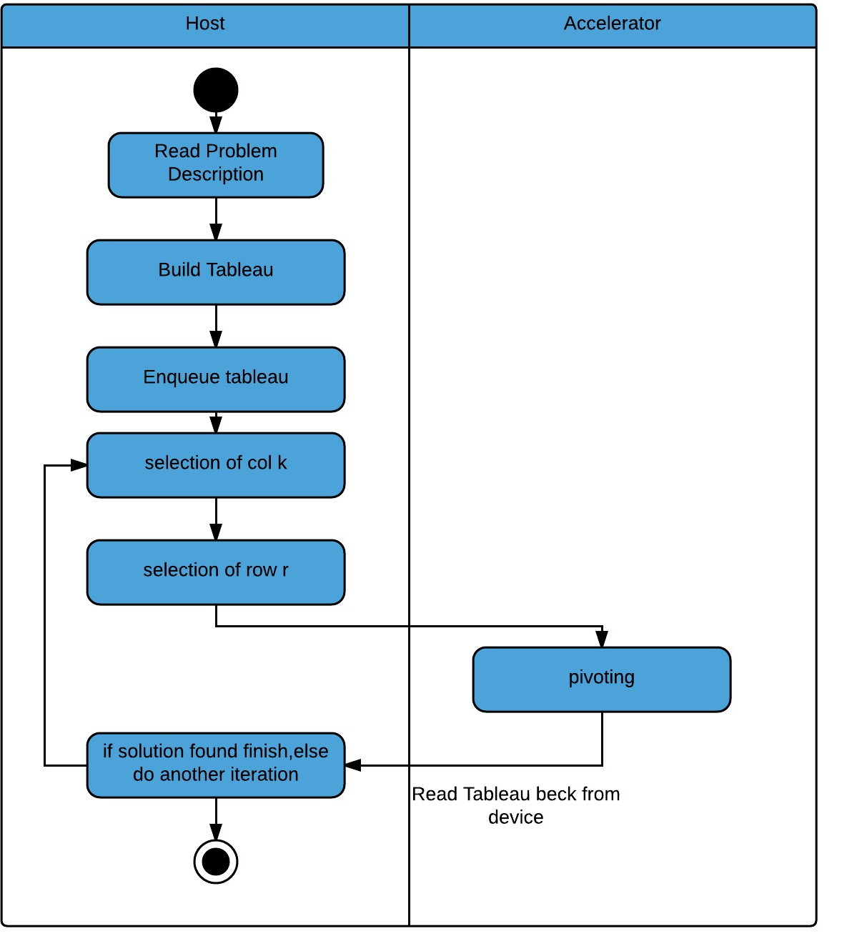
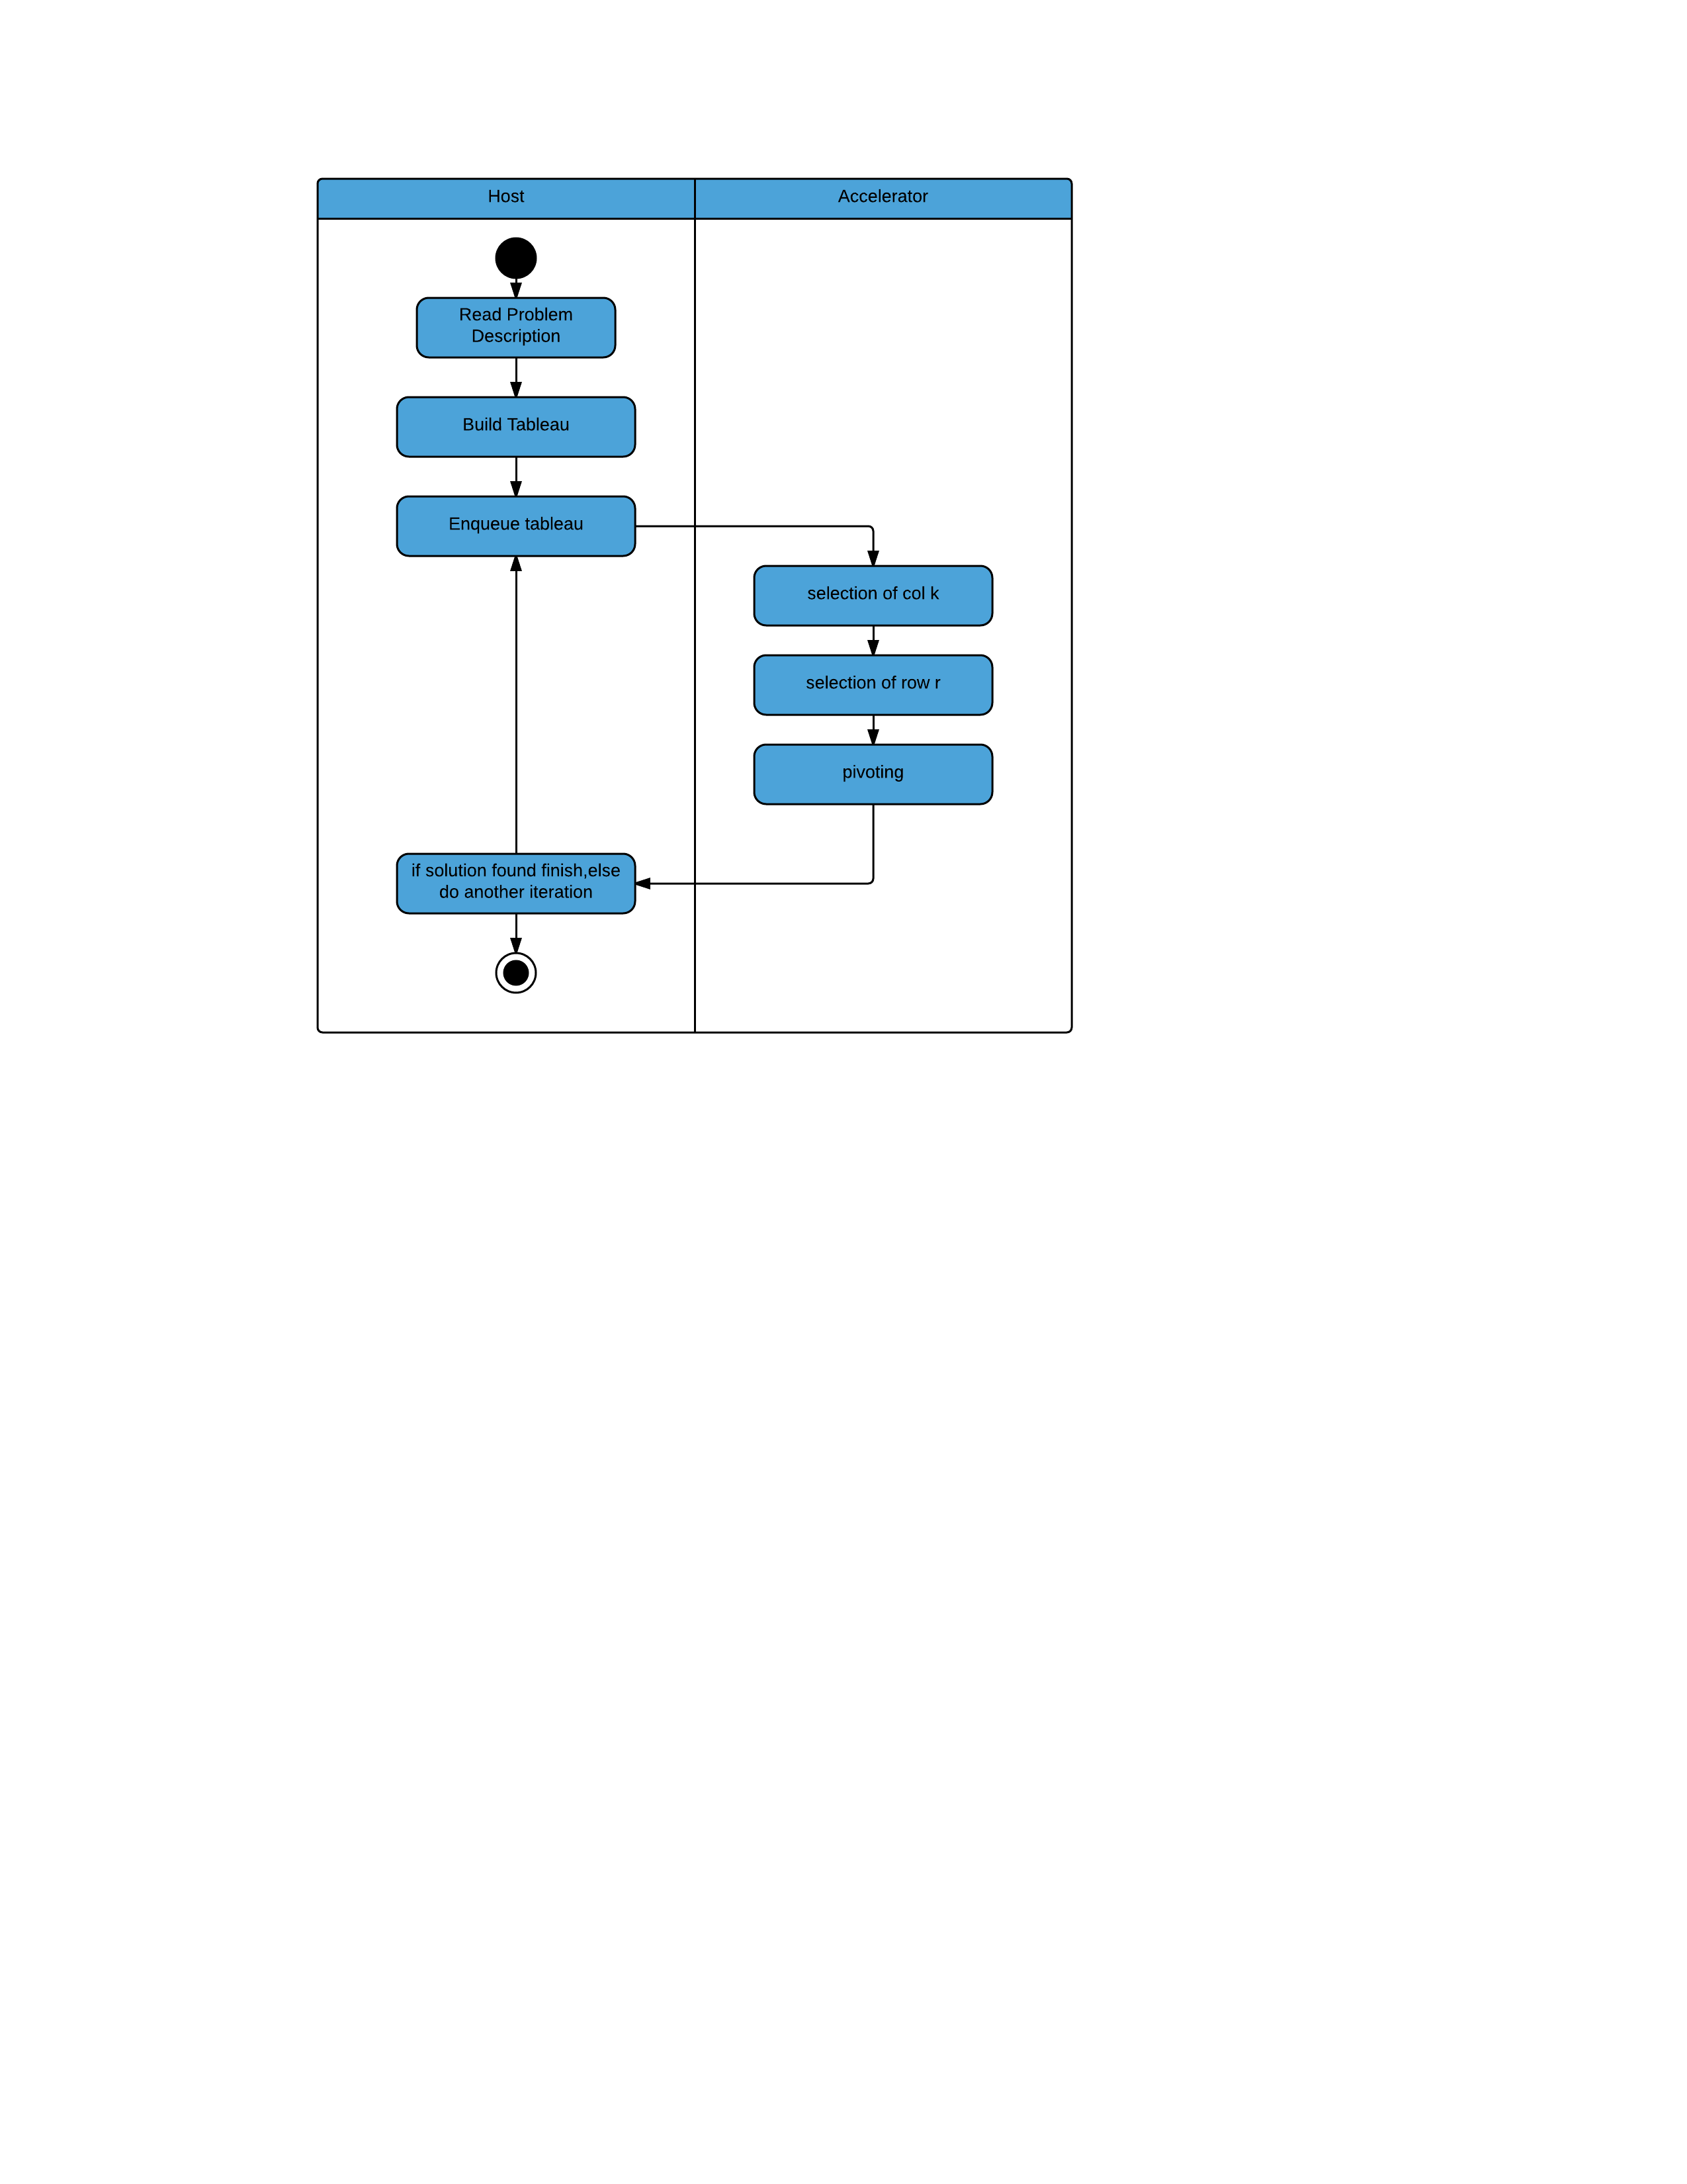
Flow of two different approaches
Fig.1 Semi-parallel approach
Fig.2 parallel approach

Slide 4
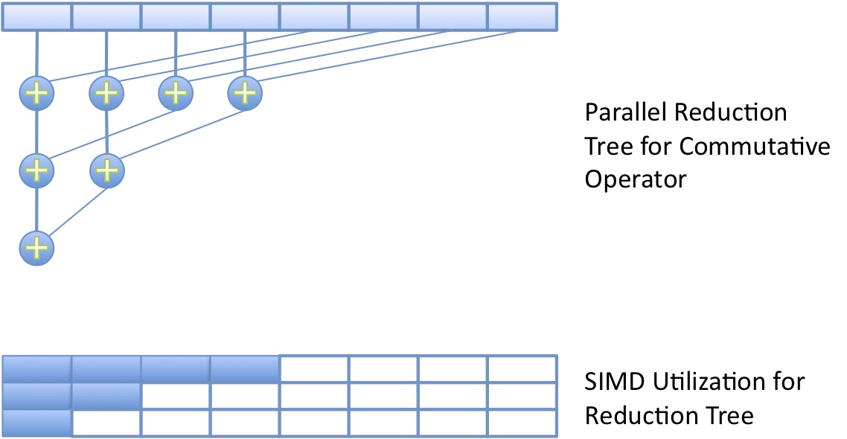
Parallel implementation of finding min/max
Image courtesy: AMD developer.amd.com
OpenCL™ Optimization Case Study: Simple Reductions

Slide 5
Returning the index of min/max value
Previous Approach only returns the min/max value, not its index in the array
In Simplex method, we are interested in indices of the value for pivot operation.
Create an index array pointing to each elements of the target array
Implement the previous algorithm on the index array only
7 | 2 | 6 | 4 | 1 | 8 | 3 | 5
0 | 1 | 2 | 3 | 4 | 5 | 6 | 7

Slide 6
Returning the index of min/max value
Previous Approach only returns the min/max value, not its index in the array
In Simplex method, we are interested in indices of the value for pivot operation.
Create an index array pointing to each elements of the target array
Implement the previous algorithm on the index array only
7 | 2 | 6 | 4 | 1 | 8 | 3 | 5
0 | 5 | 2 | 7 | 4 | 5 | 6 | 7

Slide 7
Returning the index of min/max value
Previous Approach only returns the min/max value, not its index in the array
In Simplex method, we are interested in indices of the value for pivot operation.
Create an index array pointing to each elements of the target array
Implement the previous algorithm on the index array only
7 | 2 | 6 | 4 | 1 | 8 | 3 | 5
0 | 5 | 2 | 7 | 4 | 5 | 6 | 7

Slide 8
Returning the index of min/max value
Previous Approach only returns the min/max value, not its index in the array
In Simplex method, we are interested in indices of the value for pivot operation.
Create an index array pointing to each elements of the target array
Implement the previous algorithm on the index array only
7 | 2 | 6 | 4 | 1 | 8 | 3 | 5
5 | 5 | 2 | 7 | 4 | 5 | 6 | 7

Slide 9
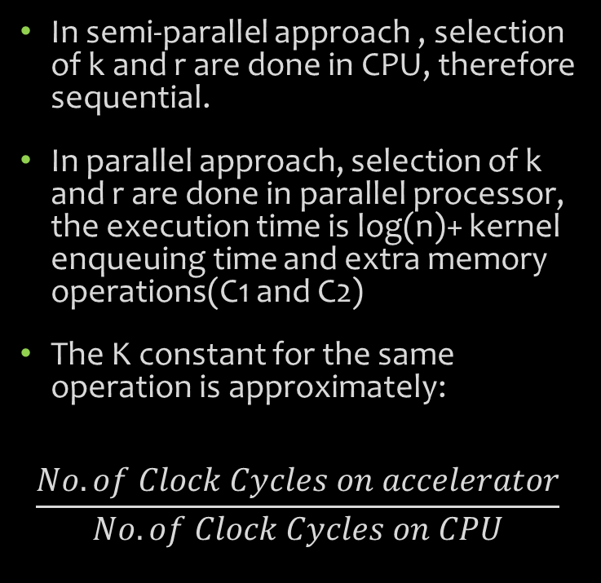
Complexity of two approaches
Parts | Semi-parallel | parallel
Selection of k | O(n) | K O(log n)+C1
Selection of r | O(n) | K O (log n)+C2
pivoting | Constant | Constant
In semi-parallel approach , selection of k and r are done in CPU, therefore sequential.
In parallel approach, selection of k and r are done in parallel processor, the execution time is log(n)+ kernel enqueuing time and extra memory operations(C1 and C2)
The K constant for the same operation is approximately:
$$\frac{No. of Clock Cycles on accelerator}{No. of Clock Cycles on CPU}$$
Table.1 Complexity of each parts of iteration

Slide 10
Round-off Errors
After a large number of iteration, round-off error occurs
Round-off Error first affects conditional statement such as k_value>=0
Theoretical value of k_value should be 0, but actually -0.000000000023
Using ranged conditions to avoid early influence of round-off errors
k_value>=0-c where c is the offset allowance from theoretical value
Early influence avoided, but when the problem size is very large, round-off errors seems unavoidable

Slide 11
Two Platform-FPGA and GPU
Two platforms are experimented with:
1.Altera Stratix 5 FPGA on Nallatech Board
2. AMD Firepro W5000 GPU
Both using OpenCL standard
Kernel Implementations are essentially the same
Unvectorized version for fair comparison
FPGA kernels requires programmer to specify workgroup size, number of compute units, the level of SIMD vectorization at compile time

Slide 12
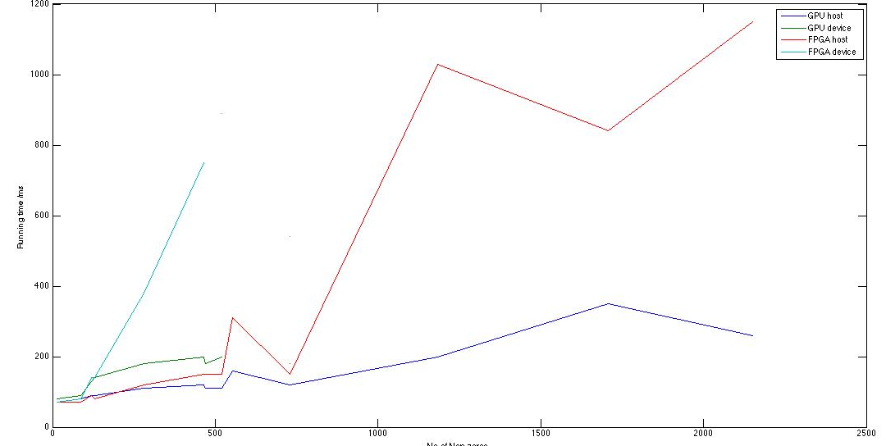
Performance of 2*2 approaches

Slide 13
Performance Analysis
Semi-parallel approach is faster than parallel approach, but theoretically only for smaller test cases. As n gets large, K log n +C>n
FPGA platforms are slower than GPU platform
The pivot-call function for FPGA takes approximately 4.5 more times to execute in the single workgroup case(i.e. there is no additional opportunity to take advantage of parallelism)
The FPGA implementation has further room of optimization

Slide 14
Further FPGA optimization
FGPA Logic usage:
Semi-Parallel Approach: 38%
Parallel Approach 55%
Semi-Parallel Approach: 2 compute units, SIMD vectorization
Parallel Approach: 2 compute units possibly, SIMD vectorization
This algorithm is not pipelined( one LP problem solved at a time).
In the case of mixed integer programming or other cases of parallel LP problems, the pipelining potential of FPGA may allow FPGA implementation to run faster

Slide 15
Future works
Studying further FGPA optimization by further vectorization, more compute units and pipelining
Explore the possibility of adjusting the offset allowance c in k_value>=0+c cases
Probably a Sparse Matrix Implementaion?

Slide 16
Thank you!

